Slide 1
CMCS
PROTOTYPE
PROG6212 POE PART THREE
ST10460420

Slide 2
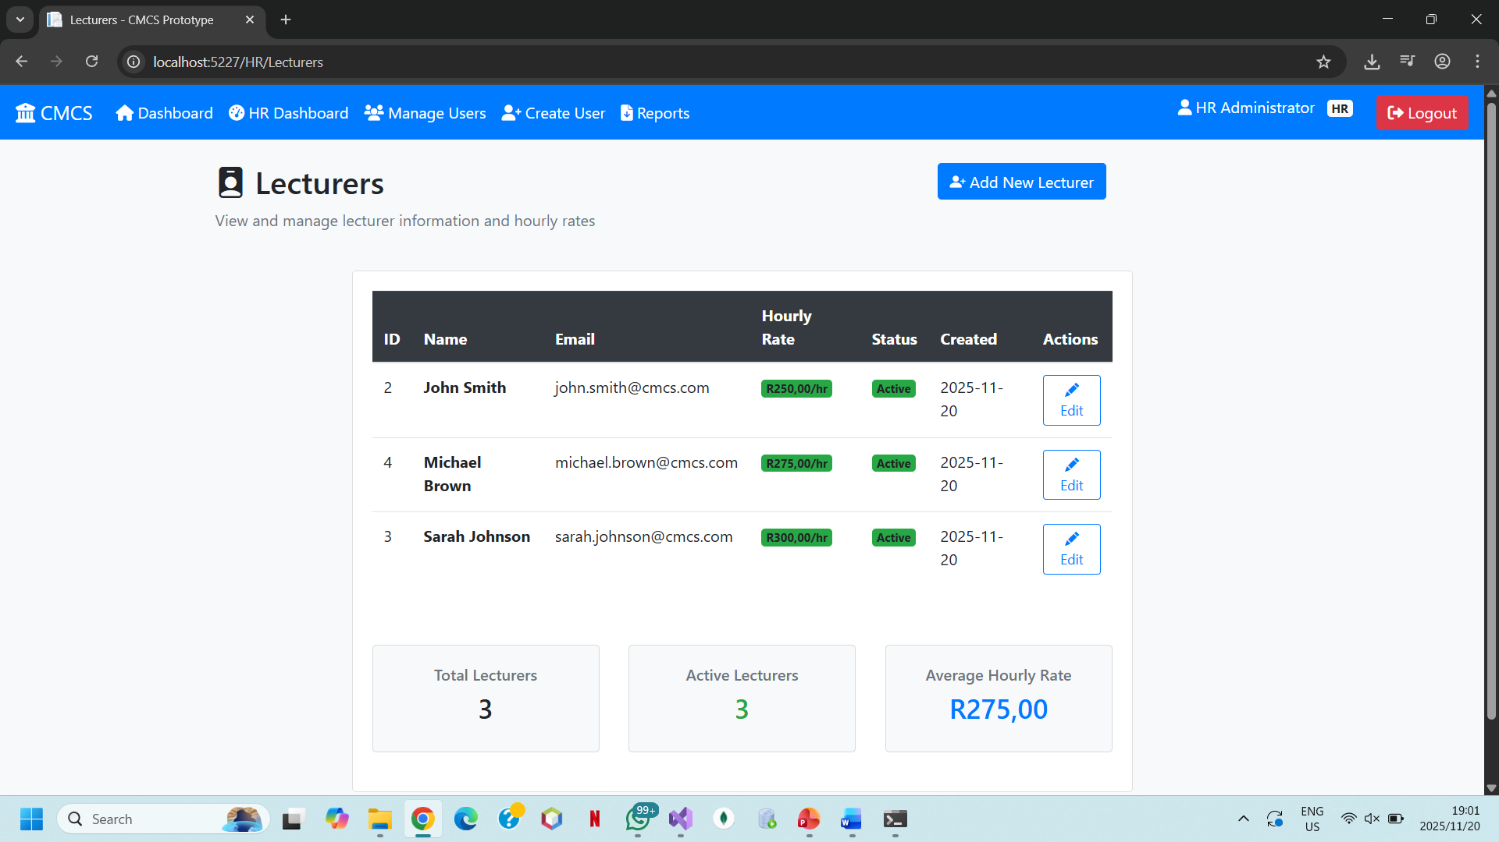
Lecturers’ Document Upload
This interface enables instructors to upload supporting papers, timesheets, and proof of work that are relevant to their monthly claims.
Important Features:
Drag-and-drop or browse functionality that is easy to use. Verify the document type to make sure the right files are uploaded.
status updates and confirmation that the upload was successful.
Value: Lowers errors and administrative burden while facilitating a smooth and effective submission procedure.

Slide 3
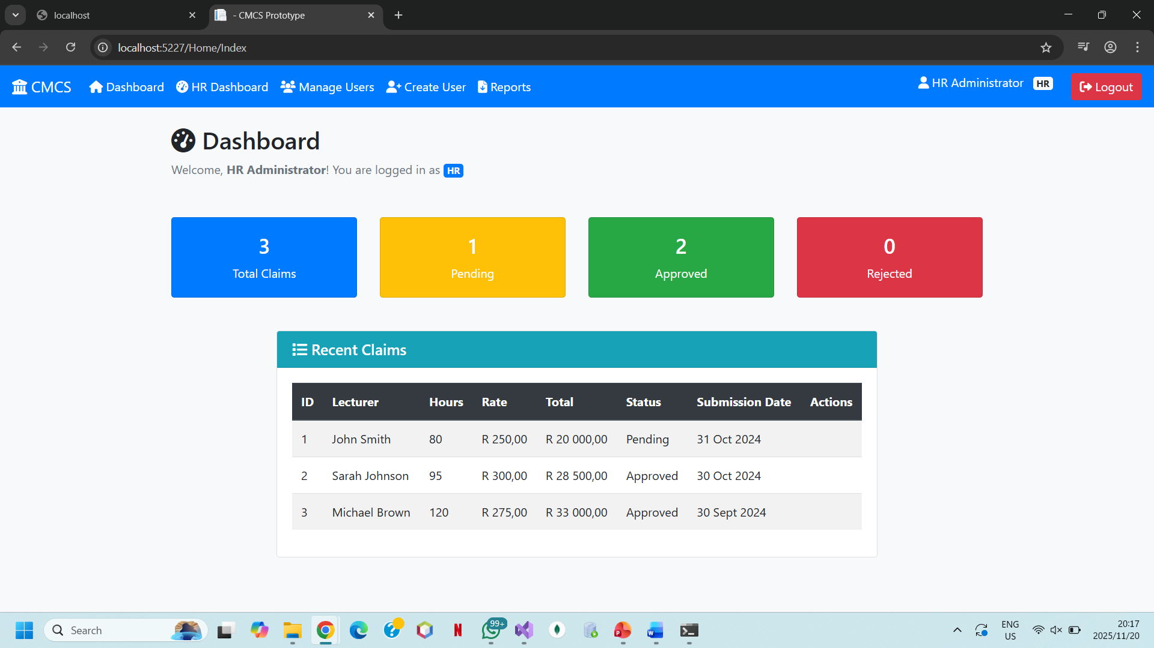
Lecturers Claim Submission
This screen enables lecturers to submit their monthly payment claims
Claims can be reviewed and edited prior to final submission. Validation is in real time to prevent mistakes
Value: Ensures accuracy, completeness and timely filing by improving the claims process

Slide 4
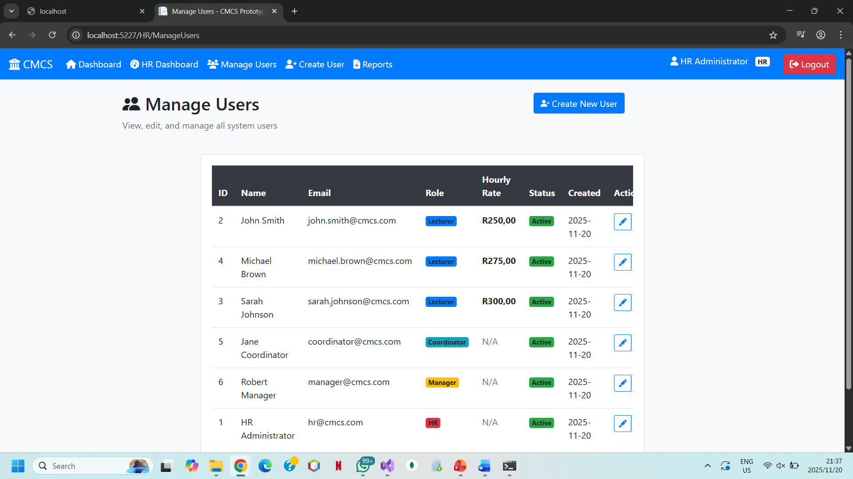
Managers View
Provides coordinators and supervisors a dashboard to examine and manage submitted claims
There are a summary of claims that have been accepted and pending. Moreover, there is thorough examination of claims with document access
Value: Promotes effective supervision, communication, and processing of claims between lecturers and management

Slide 5
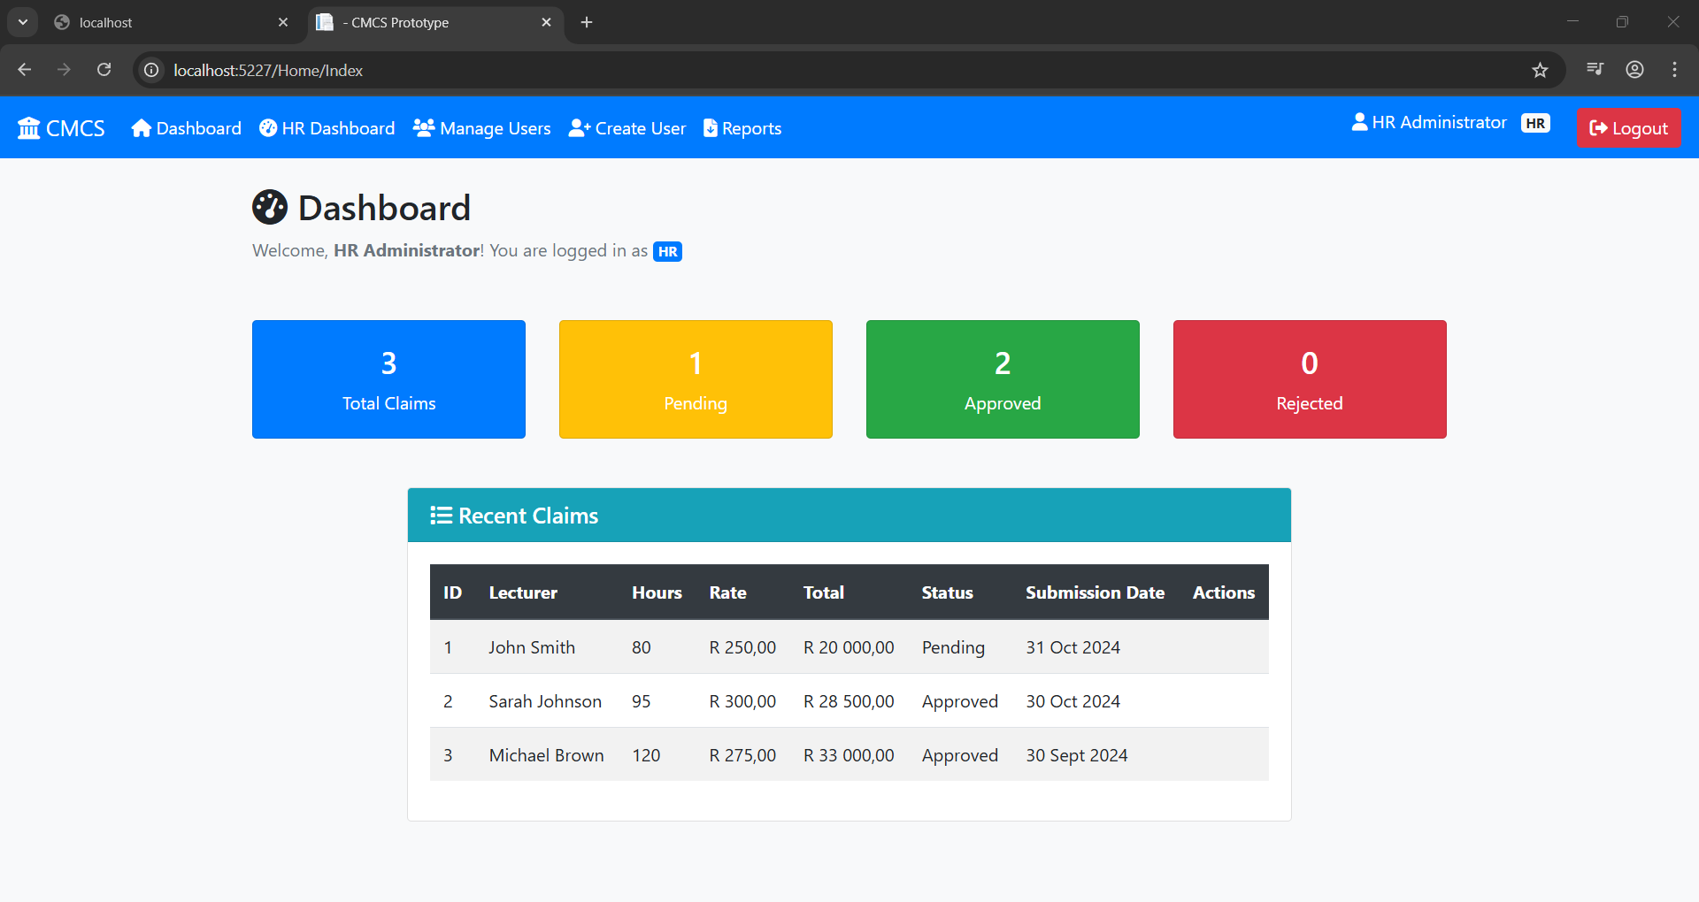
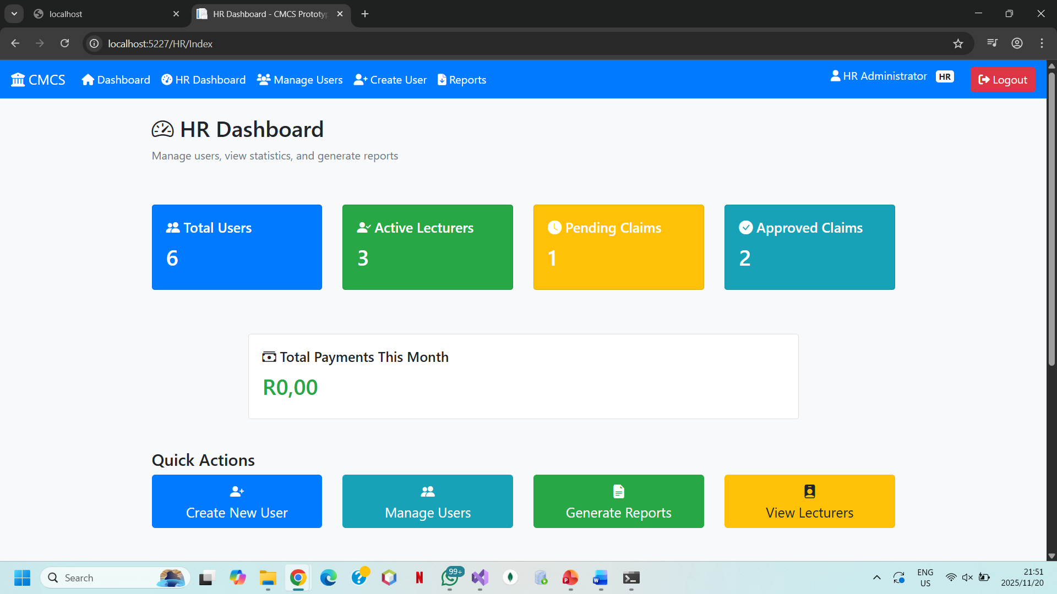
GUI Design
The screenshots show the design decisions for my interface
There is easy navigation and a layout that is simple
I chose a consistent colour scheme and font
Usability across devices is ensured with a flexible design
Value: By making the system accessible and easy to use, which improves user experience

Slide 6
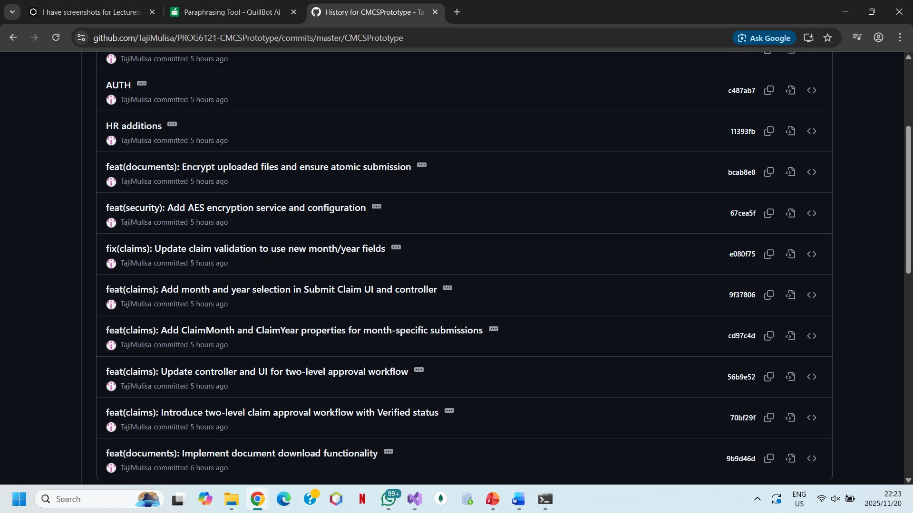
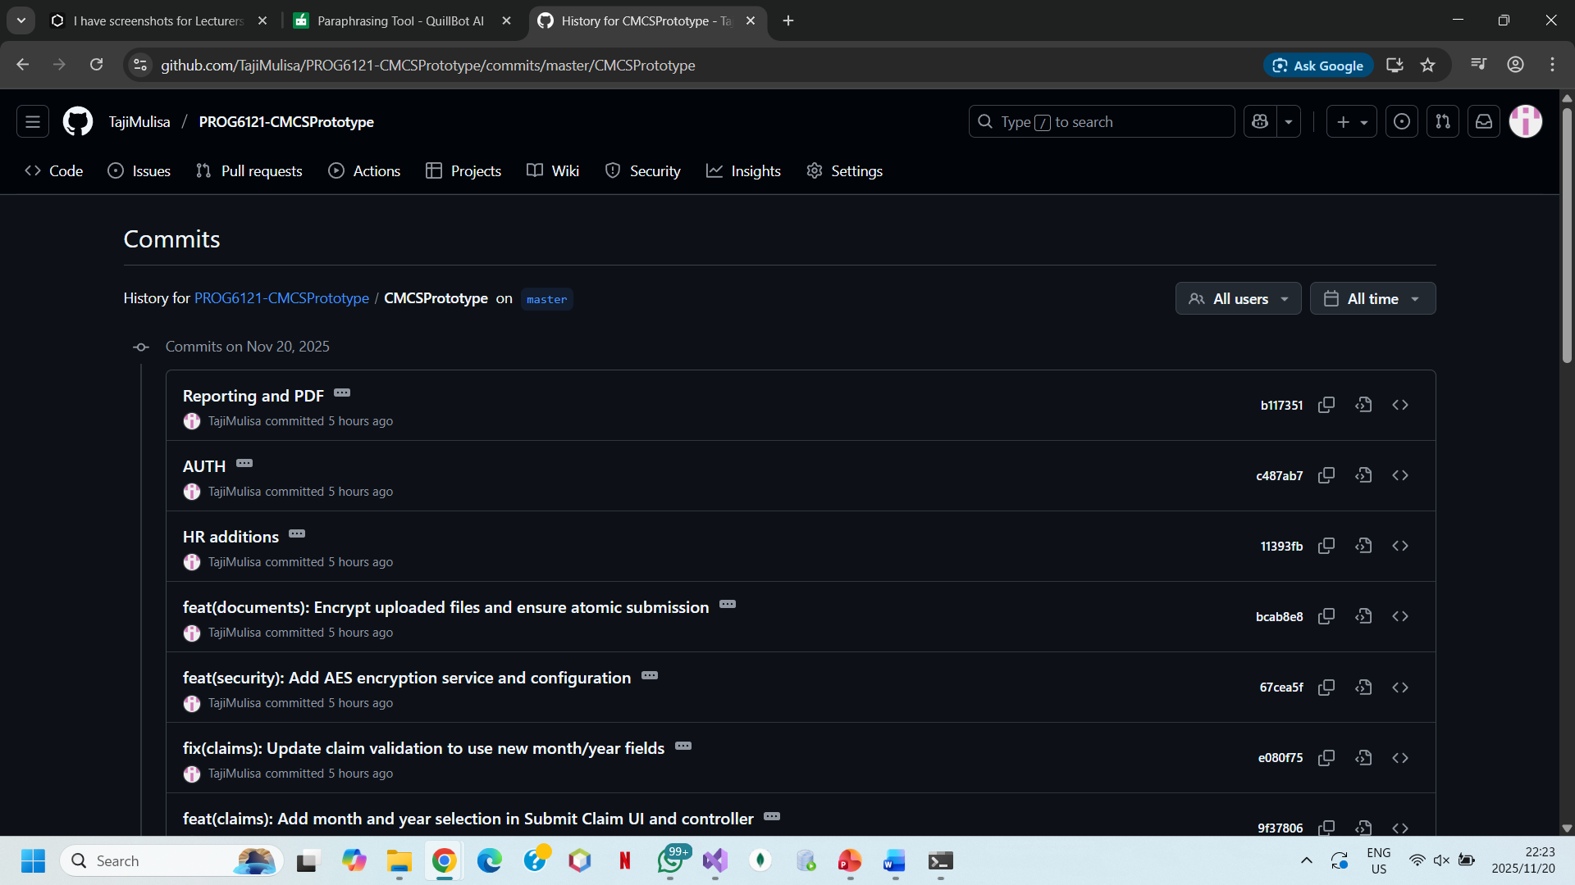
Version Control
I followed version control guidelines and made ten commits
Each commit was detailed, describing specific changes like improving dashboards and simplifying the GUI.

Slide 7
CONCLUSION
The Contract Monthly Claim System gives lecturers an all-inclusive way to upload papers and submit claims quickly.
It also makes it possible for program coordinators and managers to promptly assess and handle these claims.
There is organized and transparent claim handling for managers and coordinators, professional and user-friendly GUI design which guarantees usability.
Moreover, strong version control guarantees the maintainability of the system.
This program makes the monthly claim process easier, quicker and more accurate while also increasing operational efficiency, accountability and communication with the organization.
This system improves claim handling and provides efficient support

